Slide 1
Model Calibration
Advanced DARTH Workshop
April 2024

Slide 2
Motivation
Mathematical models of disease often involve a subset of parameters whose values are unknown
Common reasons include physical, feasibility, and ethical limitations
Estimate values for these parameters by matching model outputs to observed outcomes
Model calibration

Slide 3
Calibration definition
Process of adjusting model input parameter values to match data on an outcome of interest (e.g., survival, prevalence, or incidence)
Outcome(s) of interest = “calibration targets”

Slide 4
Calibration process
KNOWN PARAMETERS
MODEL
OBSERVABLE HEALTH OUTCOMES
UNKNOWN PARAMETERS
Try different sets of parameter values
Compare against calibration targets
(Calculate “fit”)
Repeat to find “best-fitting”
set of parameter values

Slide 5
Calibration targets
Empirical data to be replicated by the model
Summary statistics (e.g. mean age of cancer diagnosis) or series of observations (e.g. age-specific incidence)
Can calibrate to multiple targets (e.g. survival and prevalence) simultaneously
Model should be able to output the outcomes of interest

Slide 6
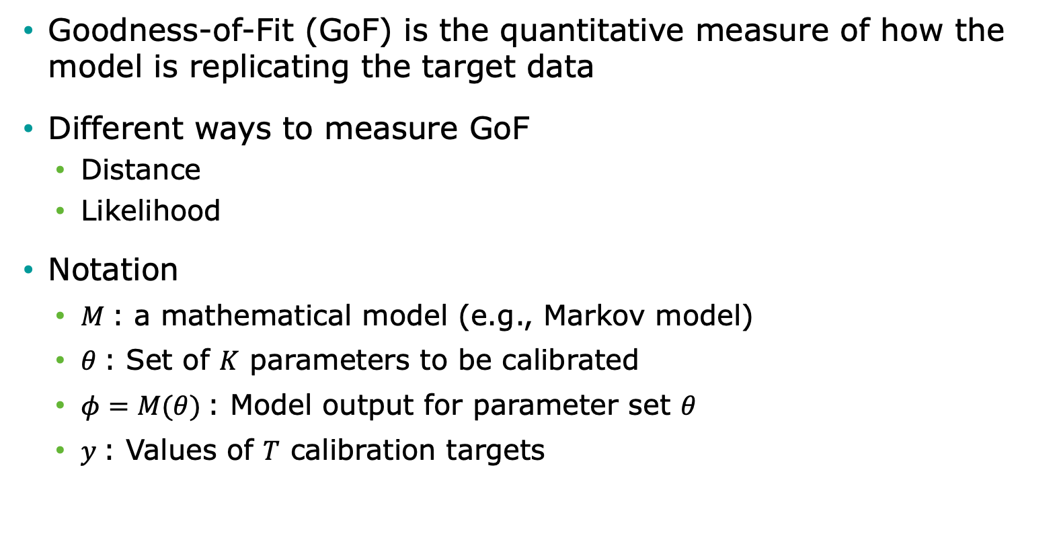
Calculating “fit”
Goodness-of-Fit (GoF) is the quantitative measure of how the model is replicating the target data
Different ways to measure GoF
Distance
Likelihood
Notation
$M$: a mathematical model (e.g., Markov model)
$θ$: Set of $K$ parameters to be calibrated
$φ=M(θ)$: Model output for parameter set $θ$
$y$: Values of $T$ calibration targets

Slide 7
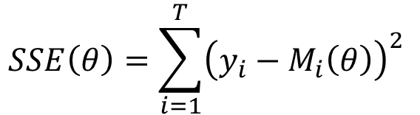
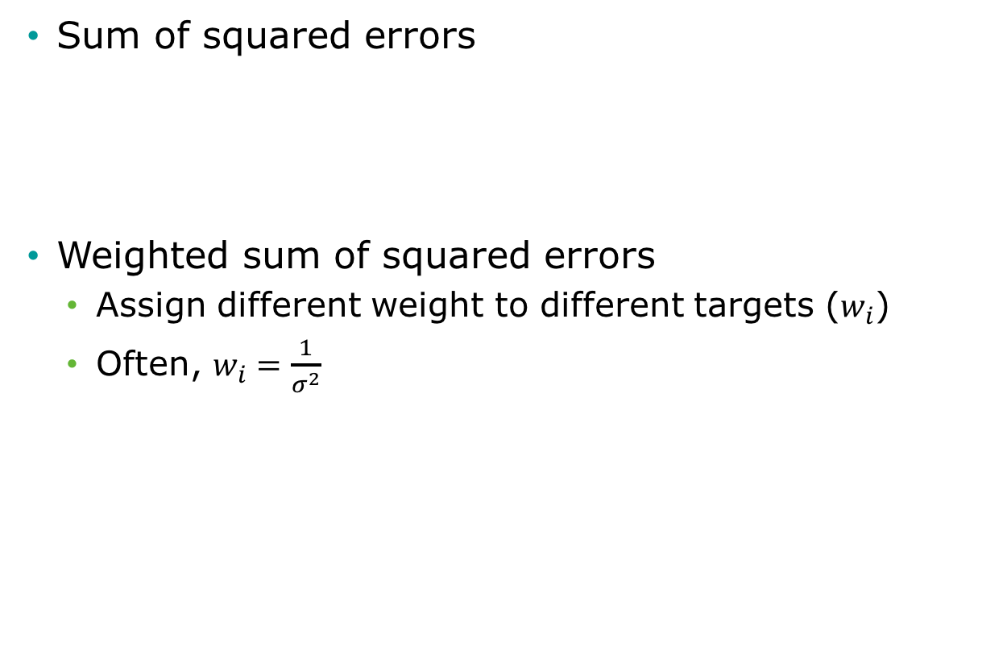
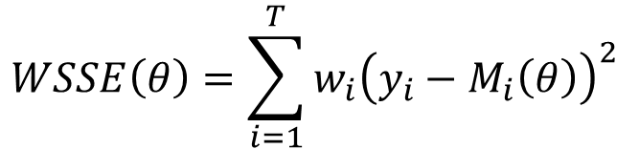
Distance GoF measures
Sum of squared errors
Weighted sum of squared errors
Assign different weight to different targets ($w_{i}$)
Often, $w_{i}=\frac{1}{σ^{2}}$
$$SSE\left(θ\right)=\sum_{i=1}^{T}{{\left(y_{i}−M_{i}\left(θ\right)\right)}^{2} }$$
$$WSSE\left(θ\right)=\sum_{i=1}^{T}{{w_{i}\left(y_{i}−M_{i}\left(θ\right)\right)}^{2} }$$

Slide 8
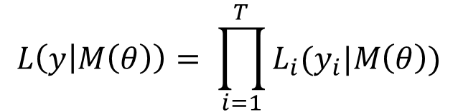
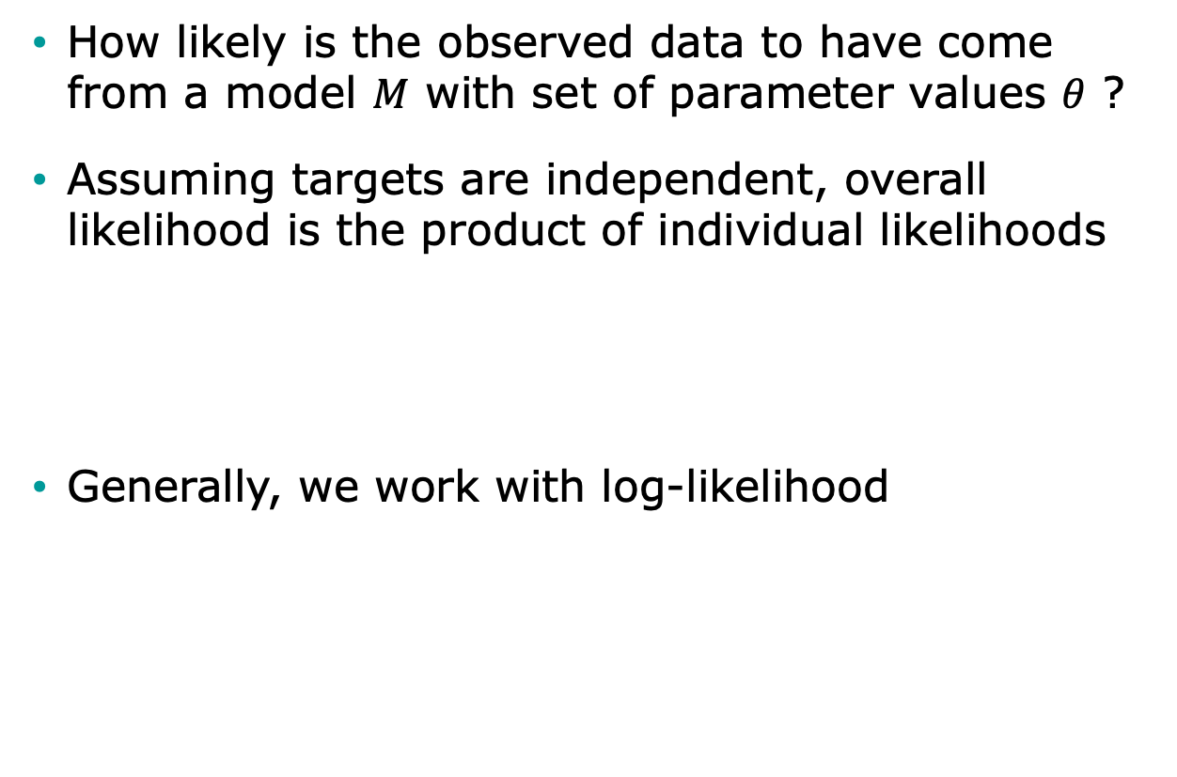
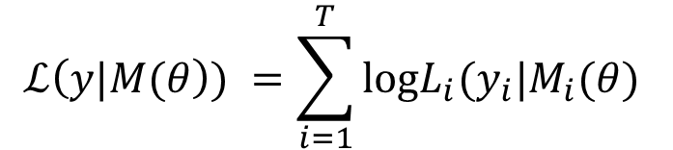
Likelihood as GoF
How likely is the observed data to have come from a model $M$ with set of parameter values $θ$ ?
Assuming targets are independent, overall likelihood is the product of individual likelihoods
Generally, we work with log-likelihood
$$L\left(y | M\left(θ\right)\right)= \prod_{i=1}^{T}{L_{i}(y_{i}|M\left(θ\right))}$$
$$ℒ\left(y|M(θ\right)) =\sum_{i=1}^{T}{\text{log}L_{i}(y_{i}|M_{i}(θ) }$$

Slide 9
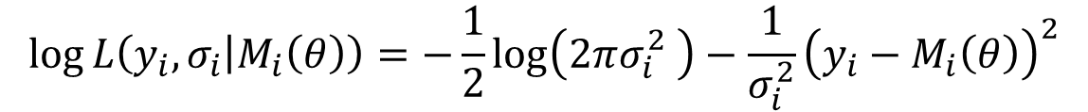
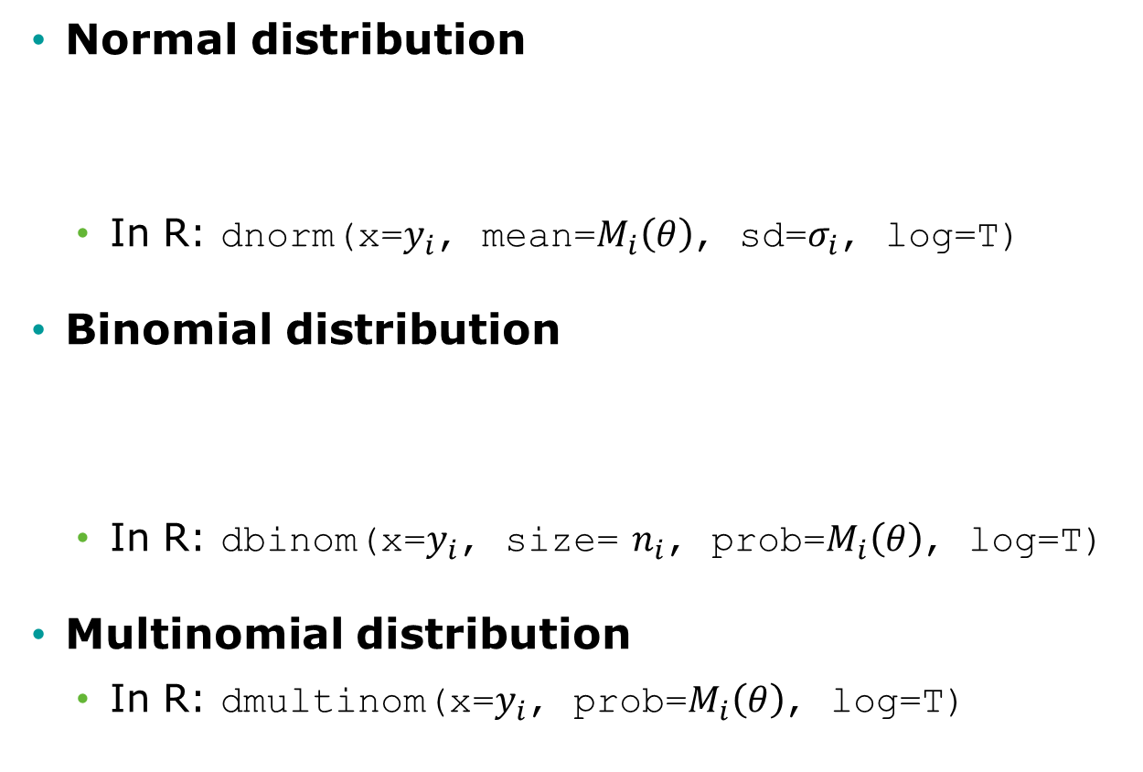
Commonly used likelihoods
Normal distribution
In R: dnorm(x=$y_{i}$, mean=$M_{i}\left(θ\right)$, sd=$σ_{i}$, log=T)
Binomial distribution
In R: dbinom(x=$y_{i}$, size= $n_{i}$, prob=$M_{i}\left(θ\right)$, log=T)
Multinomial distribution
In R: dmultinom(x=$y_{i}$, prob=$M_{i}\left(θ\right)$, log=T)
$$\log{L\left(y_{i},σ_{i} | M_{i}\left(θ\right)\right)}=−\frac{1}{2}\log\left(2πσ_{i}^{2} \right)−\frac{1}{σ_{i}^{2}}{\left(y_{i}−M_{i}\left(θ\right)\right)}^{2}$$
$$\log{L\left(y_{i},n_{i} | M_{i}\left(θ\right)\right)}=log\left(\left(\begin{matrix}n_{i} \\ y_{i}\end{matrix}\right)\right){+{ y}_{i}log\left(M_{i}\left(θ\right)\right)}+(n_{i}−y_{i})log\left(1−M_{i}\left(θ\right)\right)$$

Slide 10
Search Strategy
Define plausible ranges for parameter whose values are unknown
Use a search strategy to “search” through the input parameter space
Run the model for sets of parameter values generated by search strategy
Parameter space

Slide 11
Grid Search
Run model for all possible combinations of parameter values
Often infeasible

Slide 12
Random Search
Randomly sample a large number of parameter value sets from probabilistic distributions
Use "Latin hypercube sampling” (LHS) to ensure sample captures the full parameter space
Random sample

Slide 13
Random Search
Randomly sample a large number of parameter value sets from probabilistic distributions
Use "Latin hypercube sampling” (LHS) to ensure sample captures the full parameter space
LHS sample

Slide 14
Iterative Search
Use fits of past input values to determine which input values to try next
Directed methods
Nelder-Mead (simplex method)
Gradient–descent and others
Meta-heuristic algorithms
Genetic algorithms
Simulated annealing

Slide 15
Nelder-Mead Algorithm
Downhill simplex method
Must be run multiple times for different starting points to avoid local extrema
starting point
final value
search path

Slide 16
Example: Calibrating a 3-state cancer model
Notes:
Part 1 = Showing code 3 state model
Part 2 = Exercise build Sick-Sicker model
Part 3 = Show answers of Sick-Sicker

Slide 17
3-state cancer model
Relative survival as reported by the Surveillance, Epidemiology, and End Results (SEER) Program, represents cancer survival in the absence of other causes of death
Cancer Markov models often have a distant metastasis state, a state not directly observed in SEER, from which cancer deaths are presumed to occur
These models are used to model interventions that affect transitions to and from this state
Alarid-Escudero F, Maclehose RF, Peralta Y, Kuntz KM, & Enns, EA. Non-identifiability in model calibration and implications for medical decision making. Medical Decision Making, 2018;38(7):810–21.

Slide 18
3-state cancer model
Two unknown transition probabilities
p.Mets: Monthly risk of developing distant recurrence, range = [0.04, 0.16]
p.DieMets: Monthly risk of cancer death, range = [0.04, 0.16]

Slide 19
Target: Relative survival
Data frame “CRS_targets$Surv” stored in data file “CRS_CalibTargets.RData”

Slide 20
Calibration R code template
### Load calibration targets ###
### Load model as a function ###
### Specify calibration parameters ###
### Calibrate ###
### Explore best-fitting input sets ###

Slide 21
R Session
Notes:
Part 1 = Showing code 3 state model
Part 2 = Exercise build Sick-Sicker model
Part 3 = Show answers of Sick-Sicker

